Slide 1
E-LEARNING SYSTEM FOR THE FACULTY OF INFORMATION TECHNOLOGY
Faculty of Information Technology, Hanoi University
Nhóm 15
Trần Thị Minh Nguyệt
2201040136
Chu Minh Hiếu
2201040065
Kiều Minh Tiến
2201040155
Trịnh Văn Nam
2301040134
Nguyễn Xuân Phú
2301040149

Slide 2
WHAT WE ARE ABOUT TO ACHIEVE.
Understand the purpose of the document: Provide a foundation for analyzing, designing, and developing the E-Learning system.
Clearly understand the system objectives: Enhance proactiveness, support students in reviewing through notes, and motivate them using ranking/badge mechanisms.
Software development process, UML, MVC architecture, and REST API from the SE2 course.

Slide 3
PRESENTATION CONTENT
Part I. Introduction.
Part II. General Description.
Part III. Requirements.

Slide 4
PART I. INTRODUCTION.
Core Features: Account management, content access, lesson-based notes, progress tracking, and gamification.
Scope: A web application serving the online learning activities of students and lecturers in the IT Faculty.
The system allows students to take notes directly on each lesson to personalize their learning.

Slide 5
PRESENTATION CONTENT
Part I. Introduction.
Part II. General Description.
Part III. Requirements.

Slide 6
PART II. GENERAL DESCRIPTION.
Student: The primary learners; can manage personal info, register for courses, submit assignments, view grades, and comment.
Guest: Users who are not logged in; can register, log in, reset passwords, and view course information.
Lecturer: Content creators; can create/edit courses, manage students, create assignments, grade, and comment.
Administrator: Responsible for system operation; manages students, lecturers, news, and comments with the highest access rights.
Technology: Built on a Web platform using Java (Spring Boot) and MySQL, following the MVC architecture and using standard REST APIs.

Slide 7
PRESENTATION CONTENT
Part I. Introduction.
Part II. General Description.
Part III. Requirements.

Slide 8
PART III. FUNCTIONAL & PERFORMANCE REQUIREMENTS.
Support forum interaction (create new posts, reply to existing posts, or respond to comments).
Note-taking feature activated by highlighting text.
Security constraints: Mandatory HTTPS/TLS (>=1.2), with SSO/JWT used for authentication.
Performance limits: Response time under 3 seconds under normal loads, supporting a minimum of 100 concurrent users, with 99% availability during business hours.

Slide 9
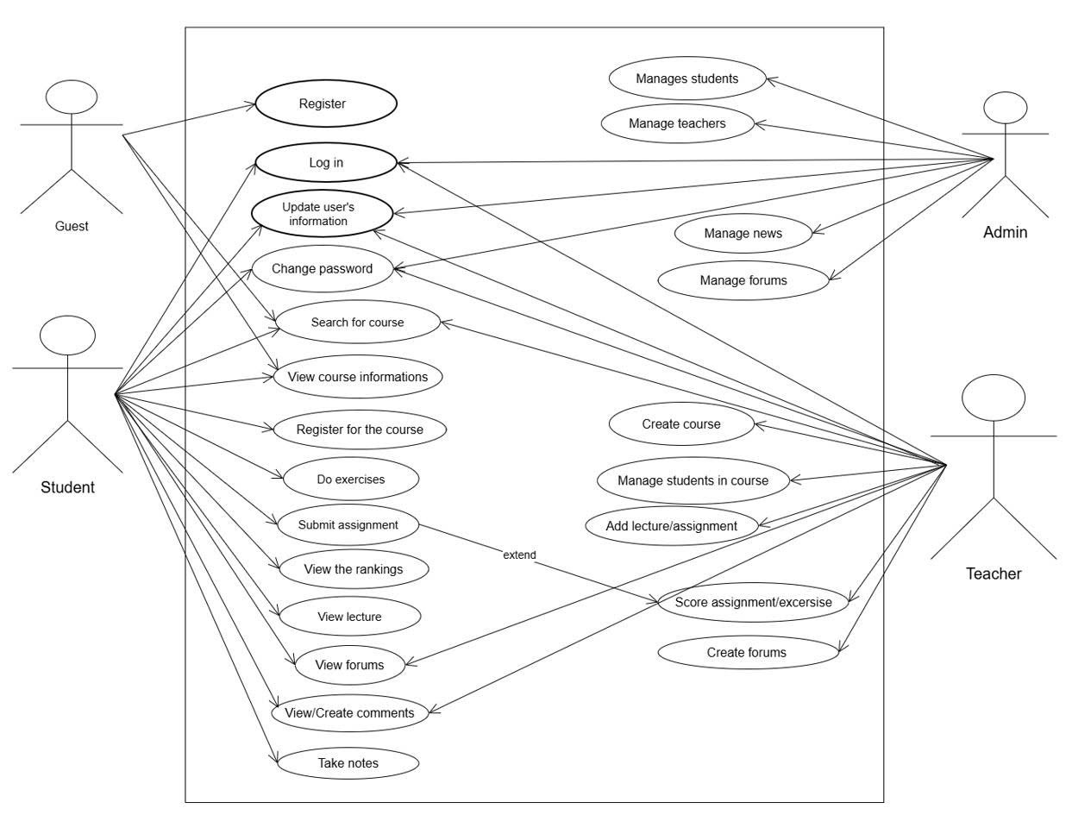
GENERAL USE CASE DIAGRAM

Slide 10
THANKS!
ANY QUESTIONS?

